Slide 1

Department of electronics and communication engineering
SINGLE ELECTRON TRANSISTOR
Supervised by:-
Dr. Dharmendra Singh Yadav
Assistant Professor
E&CE Department
NIT, HAMIRPUR
Presented by:-
Prince Kumar Pandey Roll no:- 19M407
VDAT

Slide 2
CONTENT
Introduction
Literature survey
Objective
Work of current semester
Simulation result
Summary
reference

Slide 3
Single Electron Transistor (SET)
gate
A single electron transistor is similar to a normal transistor (below), except
the channel is replaced by a small dot.
the dot is separated from source and drain by thin insulators.
An electron tunnels in two steps: source → dot → drain
The gate voltage V_{g} is used to control the charge on the gate-dot capacitor C_{g} .
How can the charge be controlled with the precision of a single electron?
source
drain
dot
SET
gate
source
drain
channel
MOSFET

Slide 4

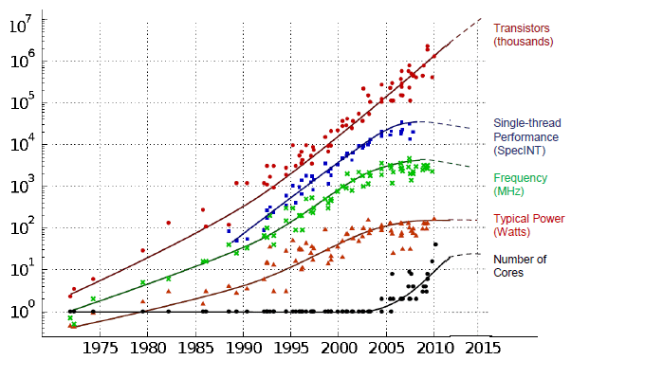
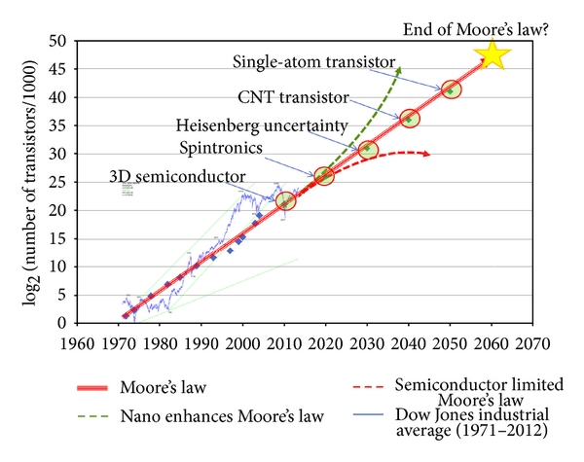
Why Single Electron Transistor
Need for Low Power VLSI Chips
Power dissipation was neglected due to
Low device density.
Low operating frequency
Now it is important issue due to
High device density
High operating frequency
proliferation of portable consumer electronics
concern on environment and energy sources
(Source-Taken from Kunle Olukotun and Herb Sutter)

Slide 5








Architecture
It consists of source drain gate and a quantum dot also known as island
Tunnel junction
island
Source and island is seperated by the insulator which form tunnel junction
Source
Drain
$$C_{1}$$
$$R_{1}$$
$$C_{2}$$
$$R_{2}$$
Tunnel is equivalent to resistance and charge is accumulated both side of the junction hence junction is combination of capacitance and resistance
gate
$$C_{g}$$
$$V_{b}$$
$$V_{g}$$
$R_{t}$= $\frac{h}{e^{2}}$

Slide 6
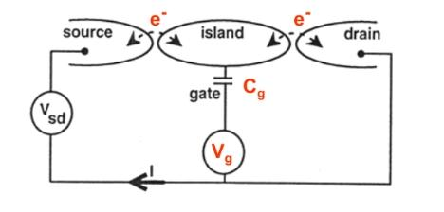
Charging a dot
Sweeping the gate voltage V_{g} changes the charge Q_{g} on the gate-dot capacitor C_{g} . To add one electron requires the voltage ΔV_{g} ≈ e/C_{g} since C_{g}=Q_{g}/V_{g}.
The source-drain conductance G is zero for most gate voltages, because putting even one extra electron onto the dot would cost too much Coulomb energy. This is called Coulomb blockade .
Electrons can hop onto the dot only at a gate voltage where the number of electrons on the dot flip-flops between N and N+1.

Slide 7

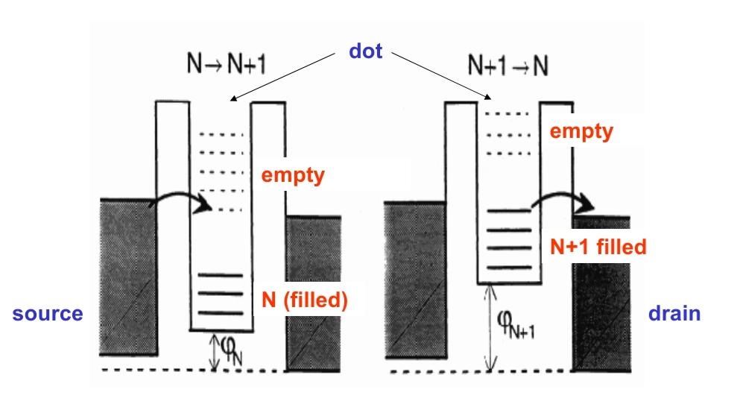



Two Step Tunneling
Initially there are N electron in the dot and electron will not tunnel through barrier as system energy is conserved
When we biased the drain then the fermi energy of the drain shifts downward
As we apply voltage to gate then the energy of the dot system is reduced and electron tunnel into the dot
Now the drain energy is less it can easily tunnel to drain

Slide 8



Condition for coulomb blocked
Two stable charge states of a dot with N and N+1 electrons are separated by the Coulomb energy.
U=$\frac{e^{2}}{C}$
The thermal kinetic energy of the electron must be less than the coulomb repulsion energy which will lead to reduction in current leading to blocked.
$\frac{e^{2}}{2C}$>kT
The dot capacitance C decreases when shrinking the dot.
Consequently, the Coulomb energy U increases.
When U exceeds the thermal energy $K_{B}^{T}$, single electron charging can be detected .
The tunneling resistance Rt derived from Heisenberg uncertainty principle
$R_{t}$= $\frac{h}{e^{2}}$

Slide 9
Literature Review
Author | Topic | Outcome
H. Inokawa Fujiwara Y. Takahashi | A multiple-valued SRAM with combined single-electron and MOS transistors Publisher: IEEE, 2001 Device Research Conference. Conference Digest (Cat. No.01TH8561) | In this paper SRAM is implemented with the help of SET and MOSFET and different parameter is obtained
Watari Kume, Yusuke Tomoda, Michinobu Hanada, Jun-ichi Shirakashi | Kume, Watari & Tomoda, Yusuke & Hanada, Michinobu & Shirakashi, Jun-ichi. (2010). Fabrication of Single-Electron Transistors Using Field-Emission-Induced Electromigration. Journal of nanoscience and nanotechnology. 10. 7239-43. 10.1166/jnn.2010.2803. | In this paper it is discussed how to fabricate SET
Amine Touati, Samir Chatbouri, and Kalboussi Adel | Design of a Single-Electron Memory Operating at Room Temperature Hindawi Publishing Corporation ISRN Nanotechnology Volume 2013, Article ID 587436 | In this work, the operation of a new design of memory cell has been described and checked by the Monte Carlo simulator SIMON.
Ahmed Shariful Alam Md. Abdur Rahman Abu Hina Md. | SET based low power consuming digital circuits 8th International Conference on Electrical and Computer Engineering IEEE, 2014 | In this paper NAND and NOR gate are implemented with the help of SET
Penki.Rohit , Dr. Gera. Anjaneyulu | Analysis and Performance Comparison of Different SRAM Cells International Journal of Advanced Research in Electronics and Communication Engineering (IJARECE) Volume 6, Issue 7, July 2017 | In this paper sram cell having different no of transistor are studied

Slide 10
Basic Equations in Master Equation Based Simulation
Free energy change.
Tunneling probability.
Steady state master equation.
Current equation.

Slide 11
Free Energy Change
Free energy in SET is difference in total charging energy and work done by external voltage source
Energy of transistor system must decrease due to tuneling
△$F_{1}^{+}$($n_{1}$, $n_{2}$)= $\frac{e}{ΣC}$ {$\frac{e}{2}$ + ( $N_{e}$- $Q_{0}$) – ($C_{g}$+ $C_{2}$)V + $C_{g}V_{g}$}
△$F_{1}^{−}$($n_{1}$, $n_{2}$)= $\frac{e}{ΣC}$ {$\frac{e}{2}$ - ( $N_{e}$- $Q_{0}$) + ($C_{g}$+ $C_{2}$)V - $C_{g}V_{g}$}
△$F_{2}^{+}$($n_{1}$, $n_{2}$)= $\frac{e}{ΣC}$ {$\frac{e}{2}$ - ( $N_{e}$- $Q_{0}$) – $C_{1}$V - $C_{g}V_{g}$}
△$F_{2}^{−}$($n_{1}$, $n_{2}$)= $\frac{e}{ΣC}$ {$\frac{e}{2}$ +( $N_{e}$- $Q_{0}$) + $C_{1}$V + $C_{g}V_{g}$}

Slide 12




Tunneling Rate
$T_{1}^{+}$(N)= $\frac{1}{e^{2}R^{1}}$ [$\frac{\text{−}\text{△}F_{1}^{+}}{1−exp⁡[{\text{△}F_{1}^{+}}/{K_{B}^{T}}}$]
$T_{1}^{−}$(N)= $\frac{1}{e^{2}R^{1}}$ [$\frac{\text{−}\text{△}F_{1}^{−}}{1−exp⁡[{\text{△}F_{1}^{−}}/{K_{B}^{T}}}$]
Tunneling rate depends on both the tunneling resistance of the junction and the total energy change of the system due to the tunneling event.
$T_{2}^{+}$(N)= $\frac{1}{e^{2}R^{2}}$ [$\frac{\text{−}\text{△}F_{2}^{+}}{1−exp⁡[{\text{△}F_{2}^{+}}/{K_{B}^{T}}}$]
$T_{2}^{−}$(N)= $\frac{1}{e^{2}R^{2}}$ [$\frac{\text{−}\text{△}F_{2}^{−}}{1−exp⁡[{\text{△}F_{2}^{−}}/{K_{B}^{T}}}$]

Slide 13


Master equation
The island charge e will change by the tunneling of electrons from or to the island as described by the equation
ρ(N)[$T_{2}^{−}$(N)+ $T_{1}^{+}$(N)] = ρ(N+1)[$T_{2}^{+}$(N+1)+ $T_{1}^{−}$(N+1)]
Current equation
I(V) = e$\sum_{N=−∞}^{N=+∞}{\text{ρ}\text{(}\text{N}\text{)[}T_{1}^{+}\text{(}\text{N}\text{)− }T_{1}^{−}\text{(}\text{N}\text{)]}}$ = e$\sum_{N=−∞}^{N=+∞}{\text{ρ}\text{(}\text{N}\text{)[}T_{2}^{+}\text{(}\text{N}\text{)− }T_{2}^{−}\text{(}\text{N}\text{)]}}$

Slide 14






Flow diagram of MATLAB program
Start
Definition of physical parameters and device parameters
no
yes
Calculation of ρ
Normalization ρ
Calculation of current I
Stop
Plot a graph

Slide 15
MATLAB Script
//Definition of constant and Device parameter
q=1.602e-19; //electronic charge (C)
kb=1.381e-23; //Boltzman constant(J/k)
c1=1.0e-20; //tunnel capacitance C1(F)
c2=2.1e-19; //tunnel capacitance C2(F)
cg=1.0e-18; //gate capacitance Cg(F)
ctotal=c1+c2+cg; //total capacitance(F)
mega=1000000;
r1=15*mega; //tunnel resistance R1(Ω)
r2=250*mega; //tunnel resistance R2(Ω)
Vg=0; //gate voltage (V)
q0=0; //background charge
temp=10; //temp T(K)
vmin=-0.5; //minimum drain voltage(V)
vmax=0.5; //maximum drain voltage(V)
NV=1000; //no of sample
dV=(vmax-vmin)/NV; //increment in drain voltage at each step
for iv=1:NV //loop for drain voltage increment

Slide 16
V(iv)=vmin+iv*dV; //drain voltage at each step
Nmin=0; //minimum charge no in dot
Nmax=20; //maximum charge no in dot
for ne=1:Nmax-Nmin //loop for N
n=Nmin+ne; //N charge no in dot
//calculation of ∆F
dF1p=q/ctotal*(0.5*q+(n*q-q0)-(c2+cg)*V(iv)+cg*Vg);
dF1n=q/ctotal*(0.5*q-(n*q-q0)+(c2+cg)*V(iv)-cg*Vg);
dF2p=q/ctotal*(0.5*q-(n*q-q0)-c1*V(iv)-cg*Vg);
dF2n=q/ctotal*(0.5*q+(n*q-q0)+c1*V(iv)+cg*Vg);
if dF1p<0
T1p(ne)=1/(r1*q*q)*(-dF1p)/(1-exp(dF1p/(kb*temp))); //T positive
else
T1p(ne)=1e-1; //T very small or negligible
end
if dF1n<0
T1n(ne)=1/(r1*q*q)*(-dF1n)/(1-exp(dF1n/(kb*temp))); //T negative
else

Slide 17
T1n(ne)=1e-1; //very small or negligible
end
if dF2p<0
T2p(ne)=1/(r2*q*q)*(-dF2p)/(1-exp(dF2p/(kb*temp))); //T positive
else
T2p(ne)=1e-1; // very small or negligible
end
if dF2n<0
T2n(ne)=1/(r2*q*q)*(-dF2n)/(1-exp(dF2n/(kb*temp))); //T negative
else
T2n(ne)=1e-1; //very small or negligible
end
End
p(1)=0.001; // for normalization
p(Nmax-Nmin)=0.001;
sum=0; //initial value for calculation for p
for ne=2:Nmax-Nmin
p(ne)=p(ne-1)*(T2n(ne-1)+T1p(ne-1))/(T2p(ne)+T1n(ne)); //calculation of p(N)

Slide 18
//to avoid divergence of MATLAB calculation
if p(ne)>1e250
p(ne)=1e250;
end
if p(ne)<1e-250
p(ne)=1e-250;
end
sum=sum+p(ne);
end
for ne=2:Nmax-Nmin
p(ne)=p(ne)/sum; //normalization
end
sumI=0; //initial I=0, for current calculation
for ne=2:Nmax-Nmin
sumI=sumI+p(ne)*(T2p(ne)-T2n(ne));
end

Slide 19
I(iv)=q*sumI;
end //end of drain voltage loop
plot(V,I); //plot of V vs I
for iv=1:NV-1
dI/dV(iv)=(I(iv+1)-I(iv))/dV; //calculation of dI/dV
end
figure;
plot(V(1,1:NV-1),dI/dV); //plot of dI vs dV

Slide 20








Simulation results of MATLAB
Tunnel junction
island
Source
Drain
$$C_{1}$$
$$R_{1}$$
$$C_{2}$$
$$R_{2}$$
gate
$$C_{g}$$
$$V_{b}$$
$$V_{g}$$
At device parameter $R_{1}$=15mΩ, $R_{2}$=250mΩ, $C_{1}$= 1*${10}^{−20}$F, $C_{2}$=2.1*${10}^{−18}$F, $C_{g}$=1*${10}^{−18}$F

Slide 21






Simulation results of MATLAB
Tunnel junction
island
Source
Drain
$$C_{1}$$
$$R_{1}$$
$$C_{2}$$
$$R_{2}$$
gate
$$C_{g}$$
$$V_{b}$$
$$V_{g}$$
At device parameter $R_{1}$=15mΩ, $R_{2}$=250mΩ, $C_{1}$= 1*${10}^{−20}$F, $C_{2}$=2.1*${10}^{−18}$F, $C_{g}$=1*${10}^{−18}$F

Slide 22
Summary
I have successfully implemented the single electron transistor in MATLAB, and obtained The graph with respect to various parameter such as graph between Vds and I at different temperature, graph between conductance and Vds and graph between Vgs and I at different temperature and different Vds.

Slide 23
Reference
[1]1999 IEEE International SO1 Conference. Oct.1999 46 , An SO1 Single-Electron Transistor
[2] International journal of VLSI design & Communication Systems (VLSICS) Vol.1, No.4, December 2010 Om kumar and Manjet kaur
[3] Design of a Single-Electron Memory Operating at Room Temperature Hindawi Publishing Corporation ISRN Nanotechnology Volume 2013, Article ID 587436
[4] SET based low power consuming digital circuits, IEEE 2014, 8th International Conference on Electrical and Computer Engineering.
[5] Analysis and Performance Comparison of Different SRAM Cells International Journal of Advanced Research in Electronics and Communication Engineering (IJARECE) Volume 6, Issue 7,
[6] www.youtube.com

